Slide 1







Introduction to data-driven critical thinking
Data Preparation

Slide 2
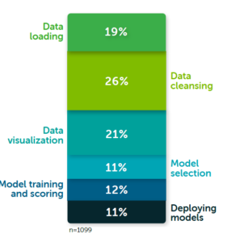
Data Preparation
What is Data preparation
Data preparation is the iterative process of manipulating and organizing data before analysis.
How data scientists spend their time (Image courtesy Anaconda “2020 State of Data Science: Moving From Hype Toward Maturity.”)

Slide 3
Data Preparation
Data cleansing
Integrity
Completeness: Comprehensive representation of the problem
Validity: No constraints are violated
Consistency
Schema conformance
Uniformity
Density
Presence of missing data

Slide 4
Data Preparation
Data cleansing
The process of detecting and correcting (or removing) corrupt records
Data auditing
Workflow specification
Workflow execution
Post-processing and controlling
DATA

Slide 5
Data Preparation
Data integration
The process of increasing the information concerning the records through the combination of different data sets
Challenges
Heterogenous data
Different schemas
High number of sources
Different time sincronization
Different abstraction levels

Slide 6
Introduction to data-driven critical thinking
Data Preparation

