Slide 1







Introduction to data-driven critical thinking
Dataiku environment

Slide 2
Dataiku environment
Installation of Dataiku DSS in Windows
Install the virtual box available in the website
Run the virtual box installed in your computer
Access to the data science platform typing http://127.0.0.1:10000/ in a navigator

Slide 3
Dataiku environment
Dataiku Homepage. Visual Grammar
Personal homepage
Projects
Applications
Wikis
Project folders
Dashboards
Flow
Datasets
Recipes
Machine learning
Worksheets -> Cards

Slide 4
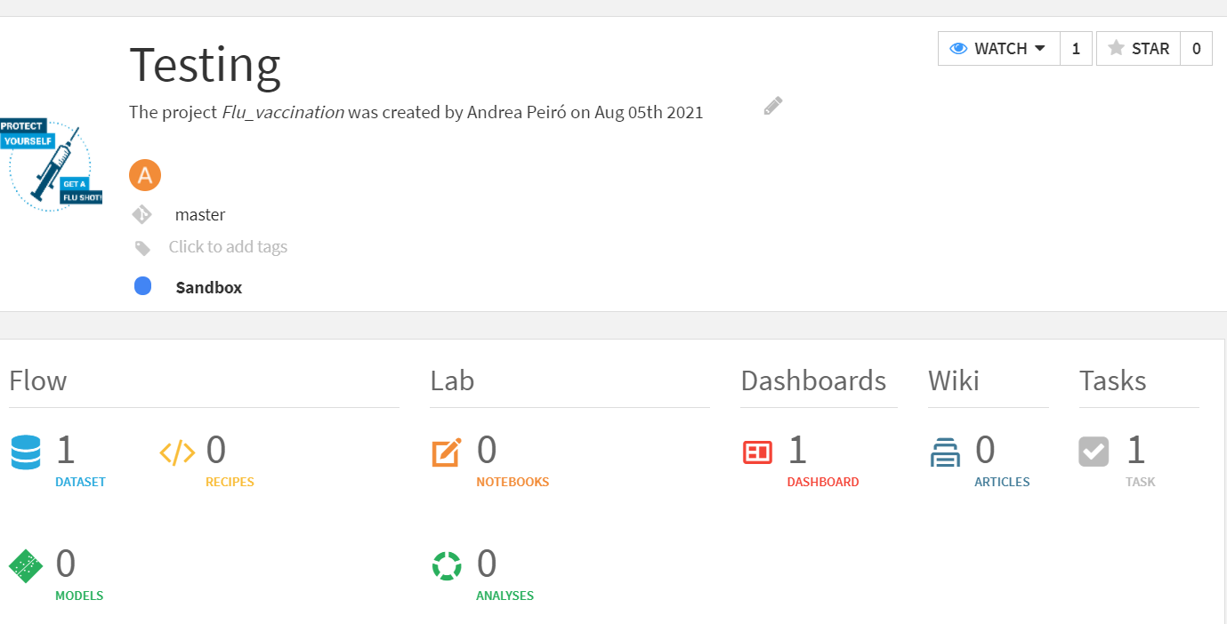
Dataiku environment
Projects
A Dataiku DSS project is a container for all your work on a particular activity

Slide 5
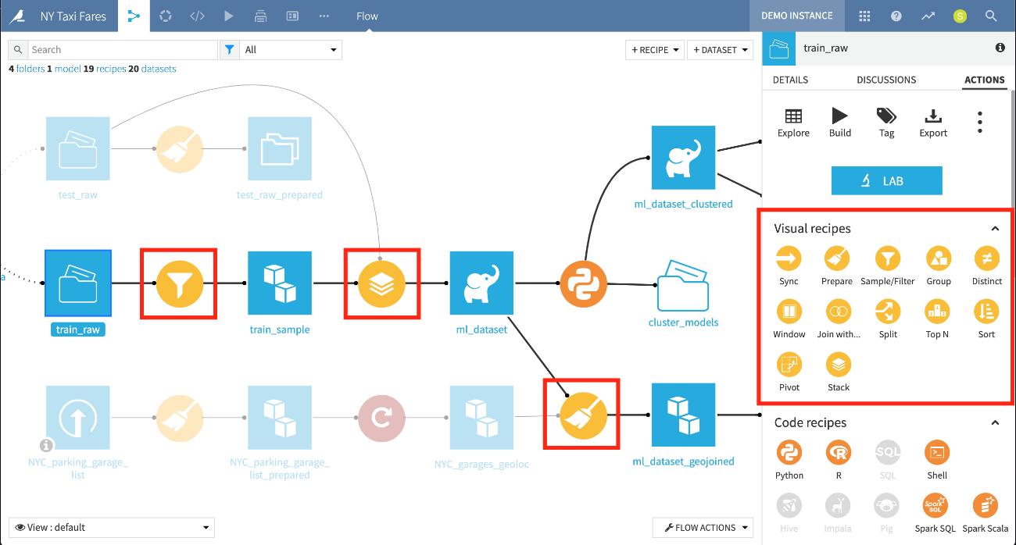
Dataiku environment
Flow and Recipes

Slide 6
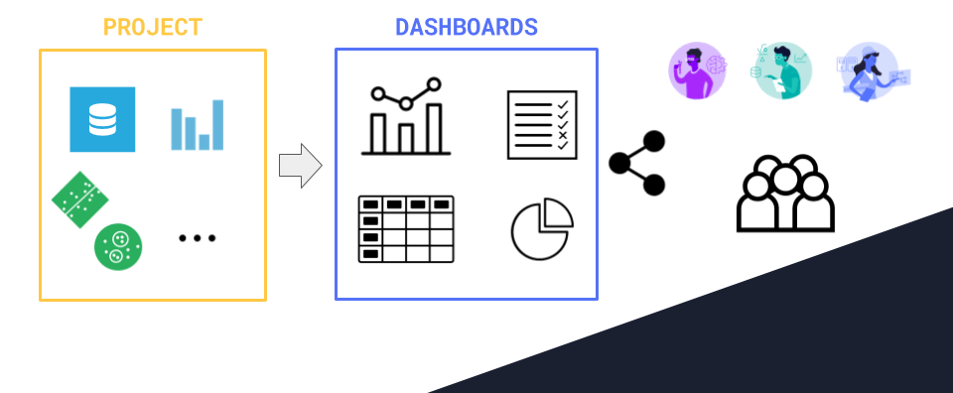
Dataiku environment
Dashboards

Slide 7
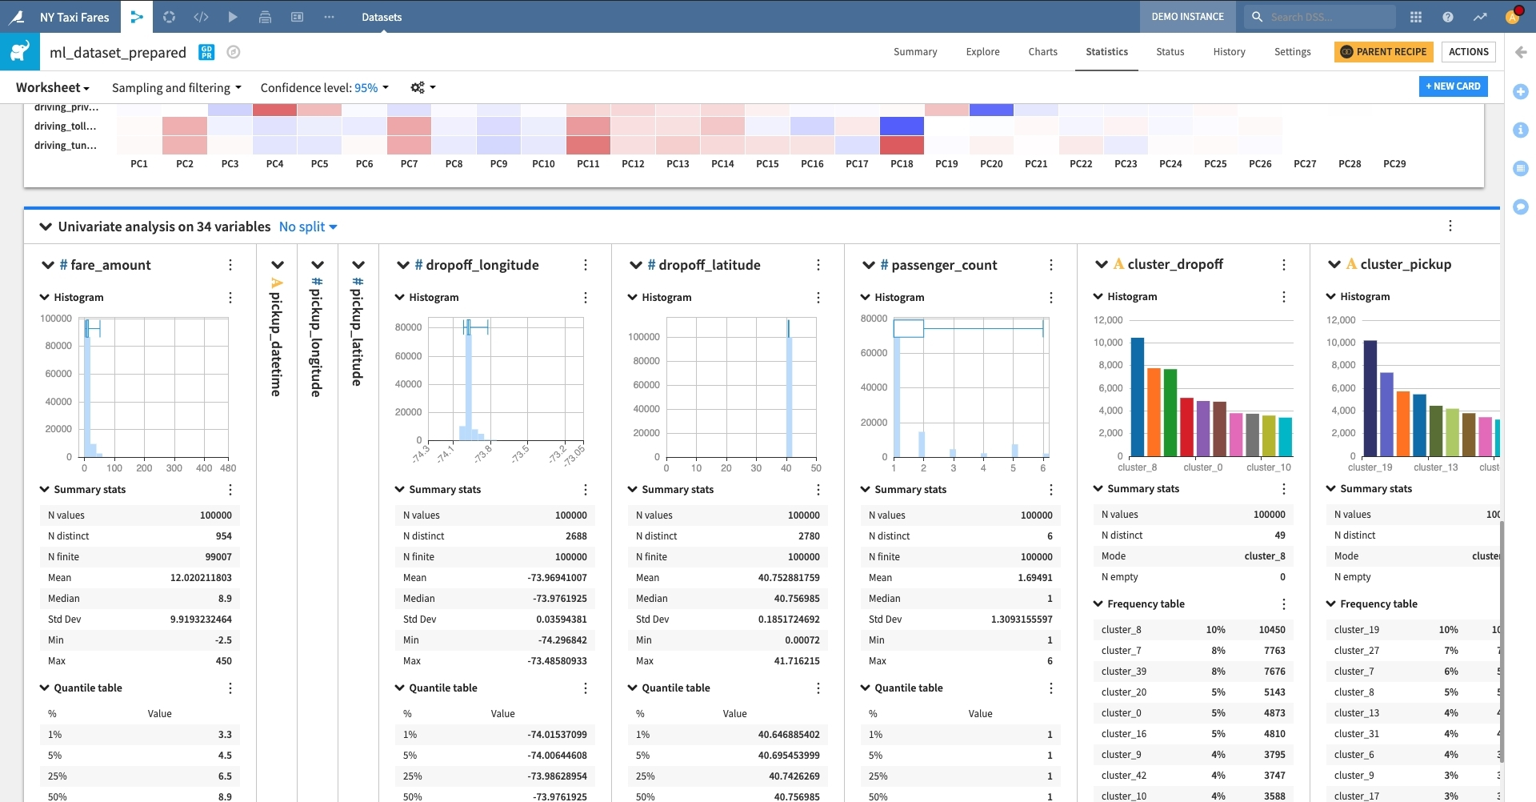
Dataiku environment
Worksheets

Slide 8
Introduction to data-driven critical thinking
Dataiku environment

