Slide 1
Introduction to data-driven critical thinking
Module I: Data collection
Data source searching

Slide 2
Data source searching
Sources of information
Qualitative sources
Primary sources: interviews, guided questionnaires, questionnaires, etc.
Quantitative sources
Primary sources: Data obtained through questionnaires
Used for the analysis of areas of recent knowledge
Formulation of new theories or knowledge
Used for fact checking or data verification.
Used in situations that have been previously analyzed exhaustively
º

Slide 3
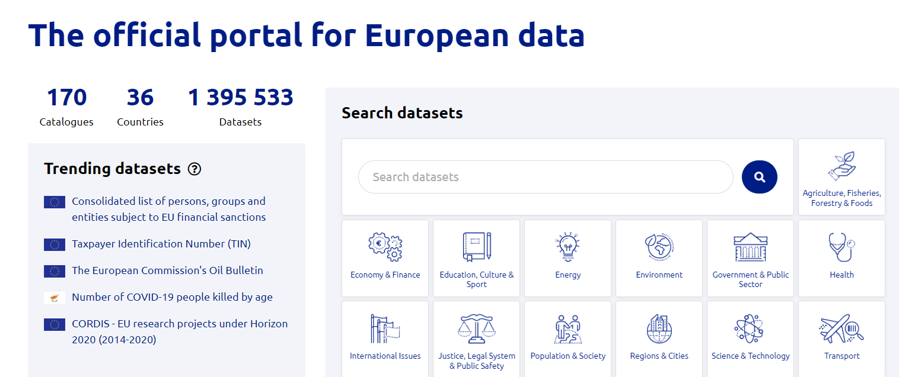
Data source searching
Open data
º
https://data.europa.eu/en

Slide 4
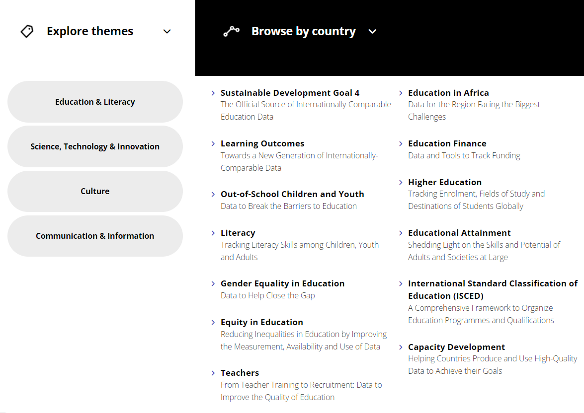
Data source searching
Data for the Sustainable Development Goals UNESCO
º
http://uis.unesco.org/

Slide 5
Data source searching
Robustness and Generalizability
Robustness: A finding is robust if it is observed regardless of small or incidental changes in experimental variables
Generalizability: a finding is generalizable if it holds across a wider variety of situations
º

Slide 6
Data source searching
Reproducibility
Reproducility
Data replication
Methods replication
Findings replication
º

Slide 7
Data source searching
The CRAAP test for evaluation of data sources
Currency, Relevance, Authority, Accuracy, and Purpose
Currency
The timeliness of the information
Relevance
The importance of the information for your needs
Authority
The source of the information
Accuracy
The reliability, truthfulness, and correctness of the content
Purpose
The reason the information exists
º

Slide 8
Introduction to data-driven critical thinking
Module I: Data collection
Data source searching

